Slide 1
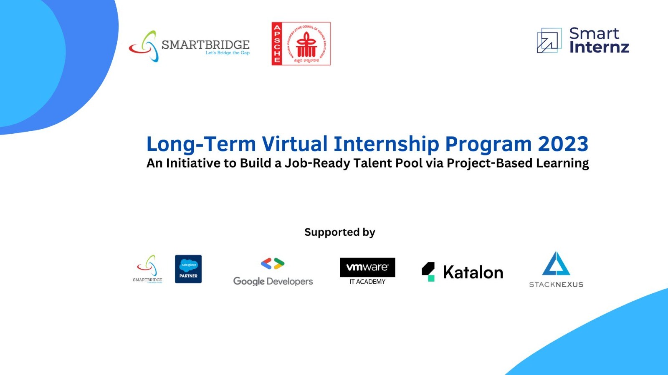

Apsche Long Internship Program
Knowledge Session - GitHub
powered by
IBM | career.education@ibm.com

Slide 2

Knowledge Session - GitHub

Slide 3
GitHub, Inc. is a platform and cloud-based service for software development and version control using Git, allowing developers to store and manage their code.

Slide 4
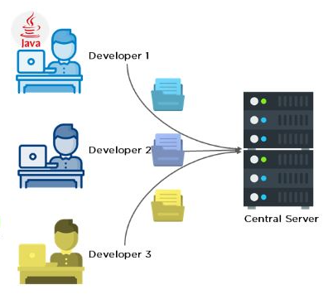
What is Git
People primarily working with source code
Anyone wants to track edits (especially changes to text files)
review history of changes
anyone wanting to share & merge changes
Developers working on the same code
Code is hosted centrally on the internet
Every developer has entire copy of the code locally

Slide 5
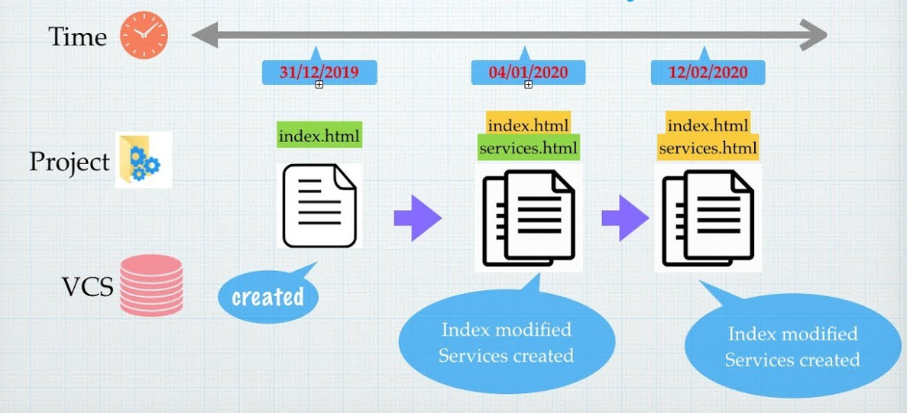
What is Version Control system ?
A way to manage files and directories
Track changes over time and recall previous versions

Slide 6
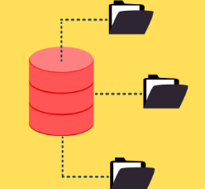
What is repository
“repo”=repository
Usually used to organize the single project
repos can contain folders and files,images,videos,spreadsheets,data sets-anything your projects needs.

Slide 7
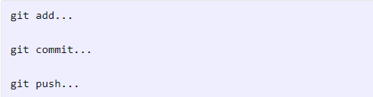
Basic Git Workflow
In general, the basic routine is:
Update your local repository with
git clone... or git pull
Edit the files locally, then

Slide 8
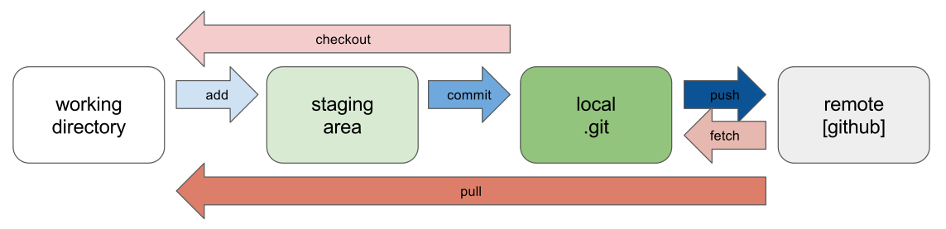
Workflow

Slide 9
Thank You

